Slide 1
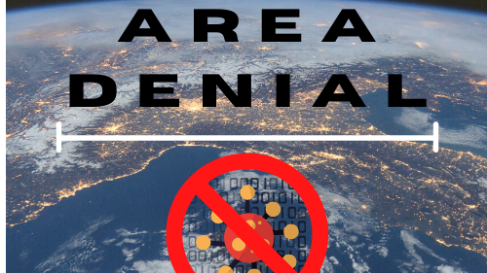
Once you start the slideshow the presentation will play automatically
– tactic that prevents passage to
severely restrict, slow down, or
endanger the opponent (the virus)
Notes:
Area denial - tactic that prevents an adversary from occupying an area of land. Preventing passage as long as it is sufficient to severely restrict, slow down, or endanger the opponent(in this case, the virus)

Slide 2

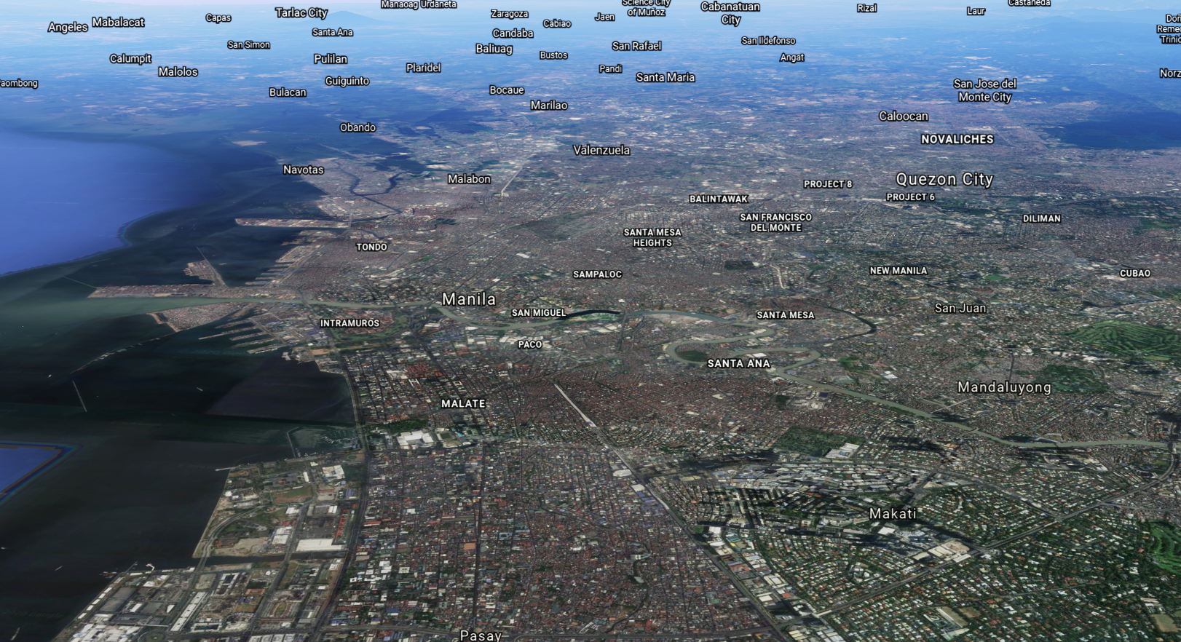
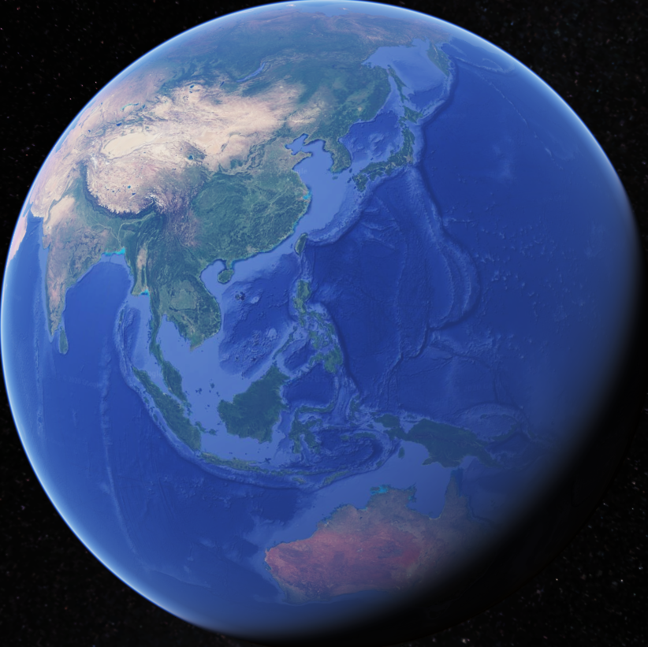
We are building a website that predicts the risk of acquiring COVID-19 in a city
pixelstalk.net
Notes:
We will be building a website that predicts how much of a COVID-19 hotspot a city is

Slide 3
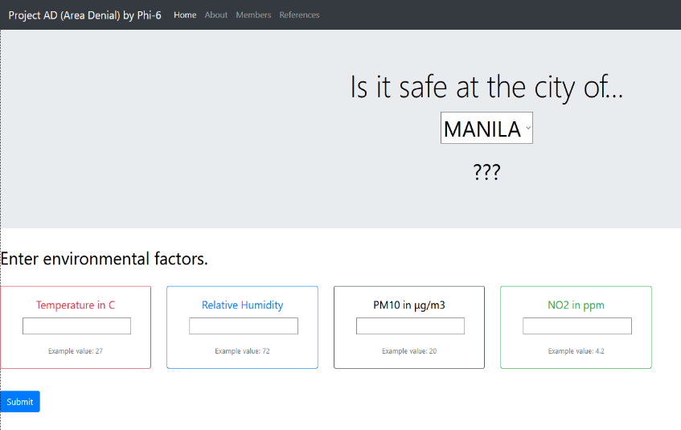
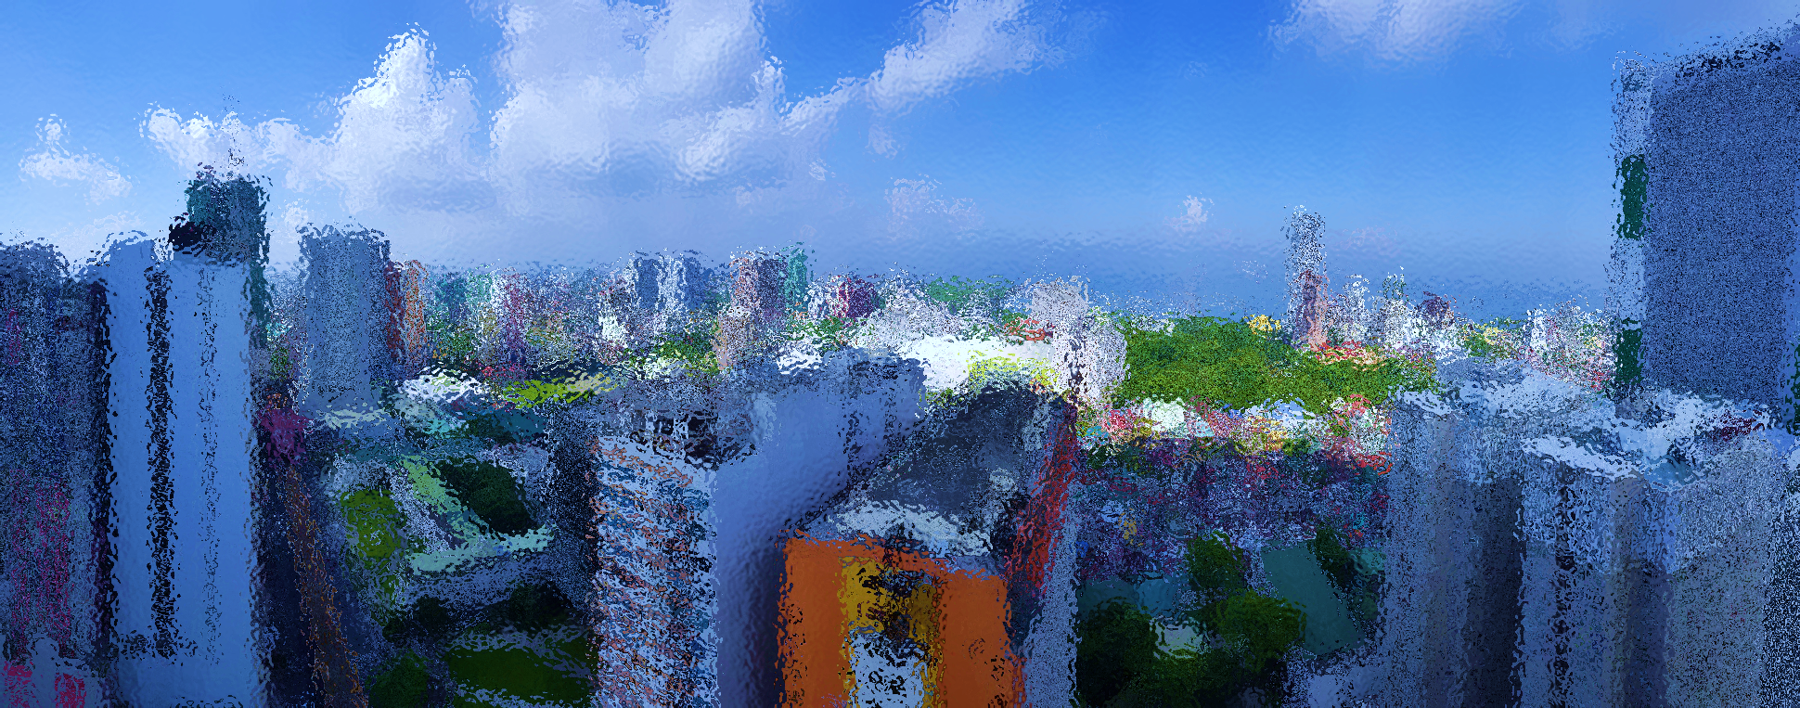
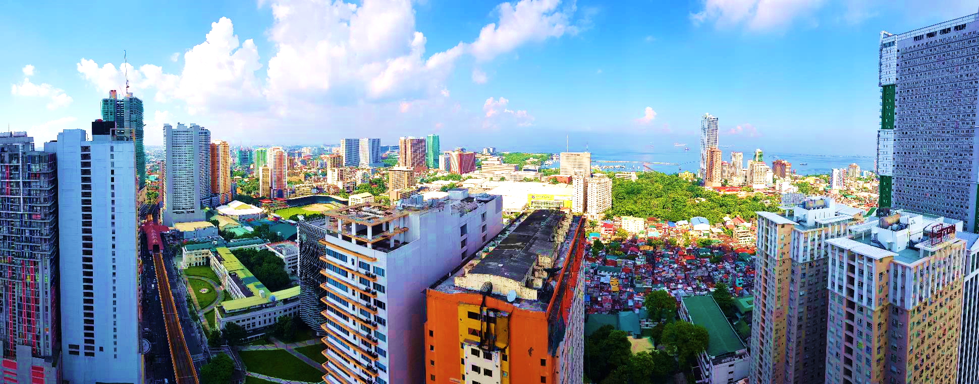


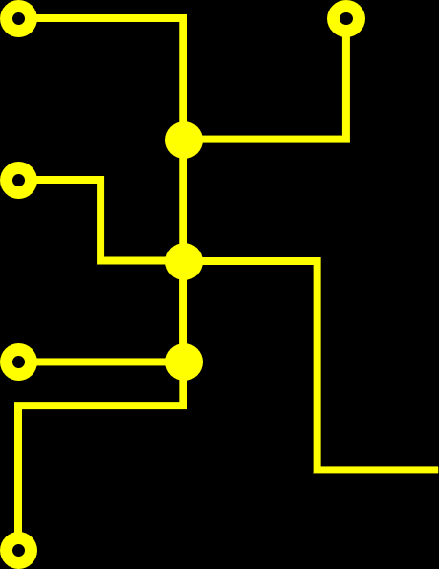





By inputting atmospheric
and epidemiologic data…
Temperature
COVID-19 Cases
Humidity
and with
computations using
“Random Forest
Regression
Technique”…
PM10
NO₂
Notes:
By combining a city’s atmospheric data, specifically air temperature, Humidity, PM 10, NO2 pollutants, and that city’s population and COVID-19 cases, we can get an idea on how safe a city is in relation to the risk of a person acquiring COVID.
-This risk is then quantified into an easy-to-understand quantity that we call “Hotspot Percentage”

Slide 4


By inputting atmospheric
and epidemiologic data…
and with
computations using
“Random Forest
Regression
Technique”…
We can make predictions on how much risk an
individual may contract COVID-19,
in a specified city at a given time

Slide 5
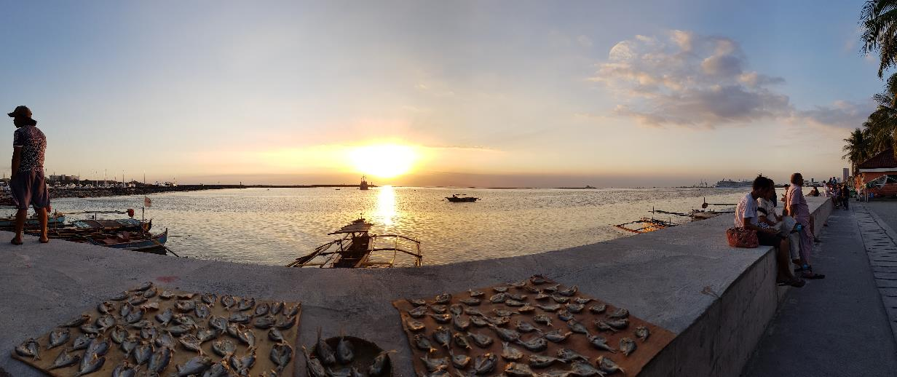
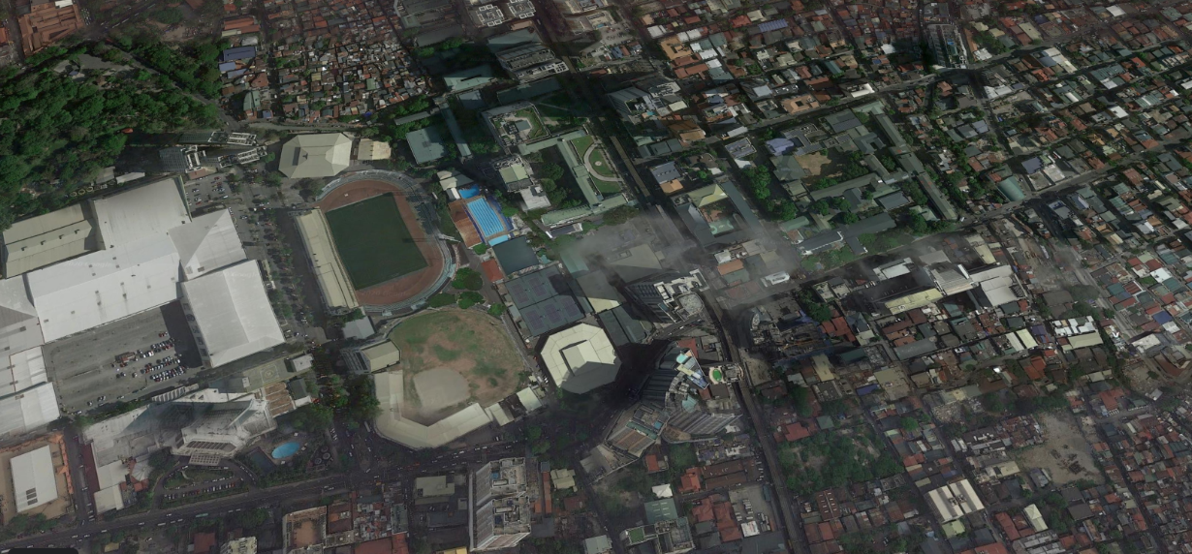
We can make predictions on how much risk an
individual may contract COVID-19,
in a specified city at a given time
Thank you for watching!
Private citizens can also
use this site, especially
for employees who
commute daily into and
out of Metro Manila
cities.
Can be a guide for…
Local government
officials in restricting
or allowing access
to their city.
National
government in
allocating healthcare
resources.

